Slide 1
PHOTO RALLY SATURDAY 24TH September
Chowder Bay
To
The Spit Bridge

Slide 2
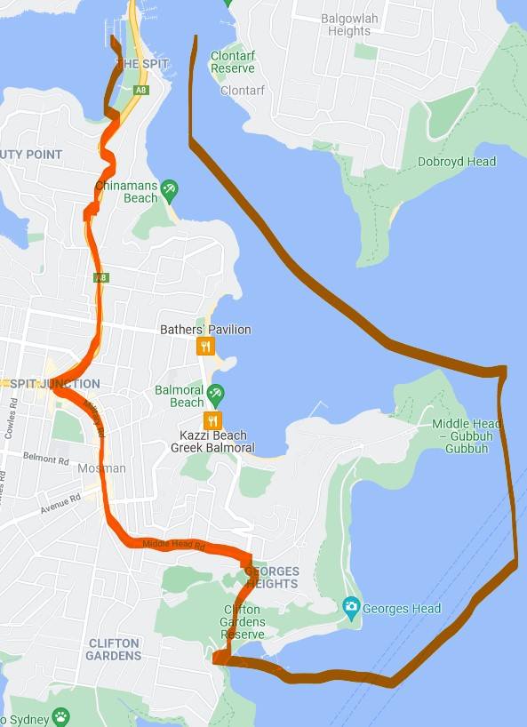

Slide 3
Geographics & Time Line
The Rally is defined as the area bounded by Spit Rd from Mosman to the southern side of the Spit bridge , Military Rd Mosman and Middle Head Rd.
It also includes Ripples at Chowder Bay accessible via Chowder Bay Rd and the park to the west of Military Rd at the Spit Bridge.
Photos may be taken looking out from within the defined area.
Photos for entry in the Photo Rally Comp on the 31st of October may be taken from the day of the Rally up to and including Sunday the 30th of October.
Suggest Communal Lunch at Balmoral Beach at either a restaurant or picnic in the park.
Walks Balmoral to Middle Head 3.9K approx. 2 Hrs
Balmoral to The Spit Bridge 4.3 K approx. 2Hrs 30Min

Slide 4
Photographic Suggestions Middle Head Fort / Balmoral Pavilion/ Chowder Bay Wharves & Buildings/ Balmoral Foreshore/ Spit Bridge & Marinas/ Local Architecture
Walking Tracks
There are several walking tracks in the area, details are available on the Wild Walks web page www.wildwalks.com.au

Slide 5
Transportation The area is governed by Mosman Council so expect to pay for parking, alternatively you can park around Mosman and catch a bus to Balmoral. Another alternative is train to St Leonards then bus to Balmoral – about a 2 hr trip or train to the city then bus to Balmoral
Lunch
As restaurants can be very expensive in the area I suggest a take away picnic at Balmoral Park 12:30

